Slide 1
Helmet Detection System using
YOLOv5
o

Slide 2
Abstract
This report presents the development and implementation of a helmet detection system using the YOLOv5 object detection framework. The primary objective is to create a model that accurately identifies individuals wearing or not wearing helmets in real-time, leveraging a dataset specific to helmet usage. This system can be instrumental in ensuring compliance with safety regulations in various industries. The project includes data collection, model training, evaluation, and deployment, culminating in a robust system that enhances workplace safety through automated monitoring.

Slide 3
Introduction

Slide 4
Introduction
The need for automatic helmet detection has become increasingly significant in domains such as construction, manufacturing, and transportation, where safety compliance is crucial. Traditional methods of ensuring helmet usage involve manual monitoring, which is not only labor-intensive but also prone to human error. An automated helmet detection system can enhance safety by providing real-time monitoring and alerts, ensuring that safety protocols are strictly followed. With advancements in deep learning and computer vision, it is now possible to develop systems that can detect helmets with high accuracy and reliability, thereby preventing accidents and ensuring adherence to safety regulations

Slide 5
Objectives
• Develop a Machine Learning Model: To create a robust model capable of detecting helmets in real-time using the YOLOv5 object detection framework.
• High Accuracy and Low False Positives: To ensure the model achieves high accuracy in detecting helmets with minimal false positives.
• Real-time Monitoring: To deploy a system that can be integrated into existing surveillance infrastructures for real-time monitoring.
• Enhanced Safety Compliance: To improve safety compliance in environments where helmet usage is mandatory.
• Scalability and Flexibility: To develop a system that can be scaled and adapted to different environments and use cases.

Slide 6
Problem Statements
Manual monitoring of helmet compliance is inefficient and error-prone. There is a need for an automated system that can continuously monitor and detect helmet usage, providing real-time alerts and ensuring compliance with safety regulations. This system must be capable of operating under varying conditions, such as different lighting and background scenarios, and should be robust enough to handle occlusions and other challenges typically encountered in real-world environments.

Slide 7
Research Survey
Several object detection models have been proposed and implemented in recent years, with YOLO (You Only Look Once) being one of the most popular due to its speed and accuracy. YOLOv5, the latest iteration, offers significant improvements in terms of performance and ease of use. Previous research has demonstrated the effectiveness of YOLO models in various object detection tasks, including helmet detection, but often with limitations in dataset availability and model optimization. Studies have shown that incorporating a larger and more diverse dataset, along with data augmentation techniques, can significantly improve model performance. Additionally, advancements in model architectures and training techniques have contributed to more accurate and efficient detection systems.

Slide 8
System Requirements
To successfully implement the Phishing URL Detection Website, you will need the following components and resources:
1. Development Environment:
- Python (version 3.8 or later)
- Google Colab or Jupyter Notebook
2.
3. Web Browser Compatibility:
- Google Chrome

Slide 9
System Requirements
4. Machine Learning Libraries:
- Scikit-learn (version 0.24.0 or later)
- Pandas (version 1.2.0 or later)
- Numpy (version 1.20.0 or later)
5. Security Libraries and APIs:
- OpenSSL
- WHOIS library or API
- DNSResolver library or API
- IPInfo API

Slide 10
System Requirements
6. Data Sources:
- Diverse dataset of URLs (phishing and legitimate)
7. Hyperparameter Tuning:
- BayesSearchCV
8. User Testing Environment:
- Variety of phishing and legitimate URLs for testing and validation.

Slide 11
Methodology
The methodology employed in the development of the Phishing URL Detection Website encompasses a series of systematic steps, integrating advanced machine learning techniques, data preprocessing, model tuning, and intuitive web development. The following sections outline each facet of the methodology:
Data Collection and PreProcessing Phase
Random Forest Classifier
Web Interface Development using Streamlit

Slide 12
Methodology
4. Supplementary Information Integration
5. User-Selectable Port Scanning
6. Evaluation and Performance Metrics

Slide 13
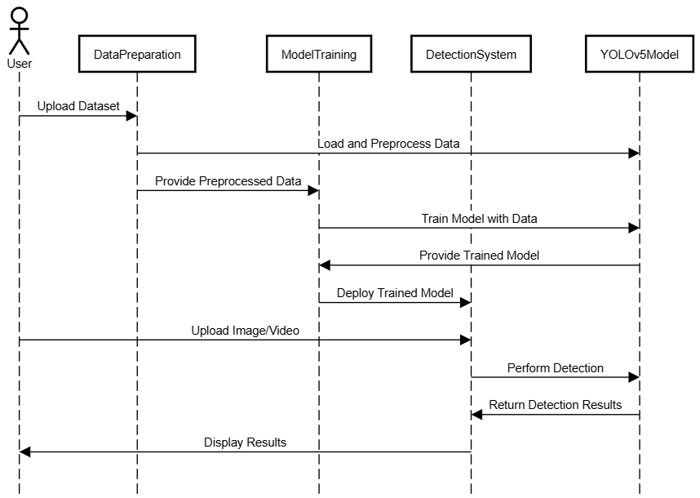
Sequence Diagram

Slide 14
Implementation

Slide 15

Implementation
The process begins with DNS resolution, translating user-entered URLs into IP addresses using DNS servers. This sets the stage for secure connections fortified by SSL/TLS protocols. SSL certificates, validated by Certificate Authorities (CAs), authenticate parties and enable encrypted data exchanges.
Domain ownership insights are facilitated through WHOIS lookup procedures, unveiling ownership details. Concurrently, port scanning evaluates potential vulnerabilities using SYN packets, providing insights into system security.

Slide 16
Implementation
Link interaction involves feature extraction and text processing, refining content from URLs. Feature generators analyze processed text, extracting insights to aid decision-making.
Machine learning integration involves the RandomForest model. With 32 parameters selected from the original 36 parameters, it classifies links based on features from URLs. Its predictive capabilities assess links, categorizing them based on predetermined criteria.

Slide 17
Implementation
The experiment for this work was performed on the CSV dataset containing a collection of URLs along with their corresponding labels indicating whether each URL is classified as a phishing website or not. The dataset is derived from the research paper titled "Detecting Phishing Websites through Deep Reinforcement Learning" authored by Moitrayee Chatterjee and Akbar Siami Namin.The dataset contains 1 lakhs URLs, out of which 50,000 are legitimate and 50,000 are phishing. The training dataset is discrete and contains deterministic classes. The proposed model can make binary predictions of observations of the test data.

Slide 18
Implementation
For the final training of the model to derive the best model - we had a resultant dataset of 84,638 rows and 32 columns. And after hyperparameter tuning, the best model turned out to be:
RandomForestClassifier(criterion='entropy', max_depth=10, n_estimators=98)
The accuracy of this model was at 93.066%.
The best model was then pickled and loaded to Streamlit website.

Slide 19
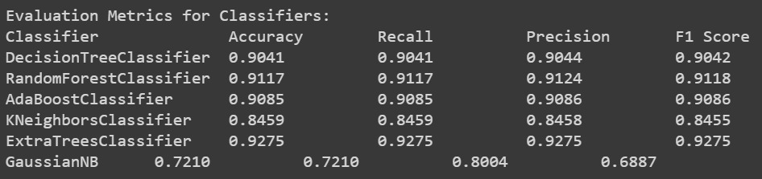
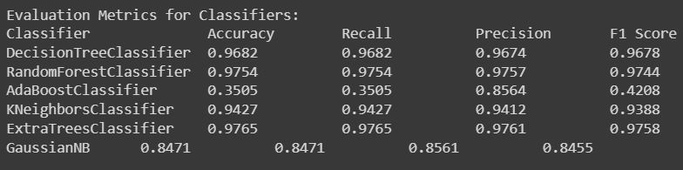
Implementation
Training Iterations:
Iteration 1-
Iteration 2-

Slide 20
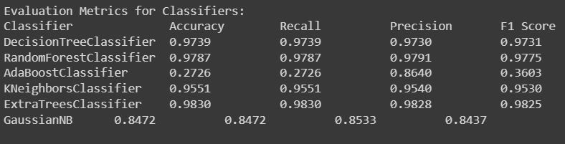
Implementation
Training Iterations:
Iteration 3-

Slide 21
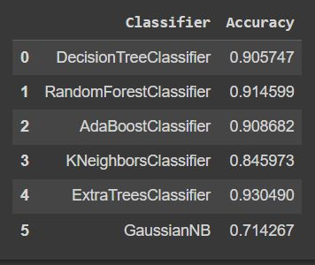
Implementation
Final Training Accuracy:

Slide 22
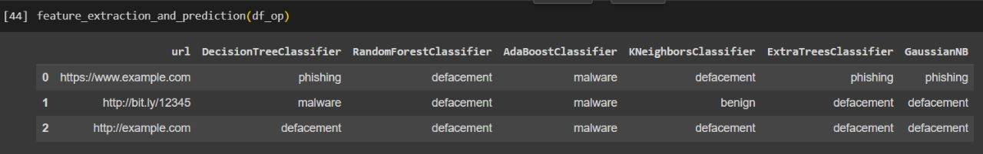
Implementation
Test Cases

Slide 23
Results

Slide 24
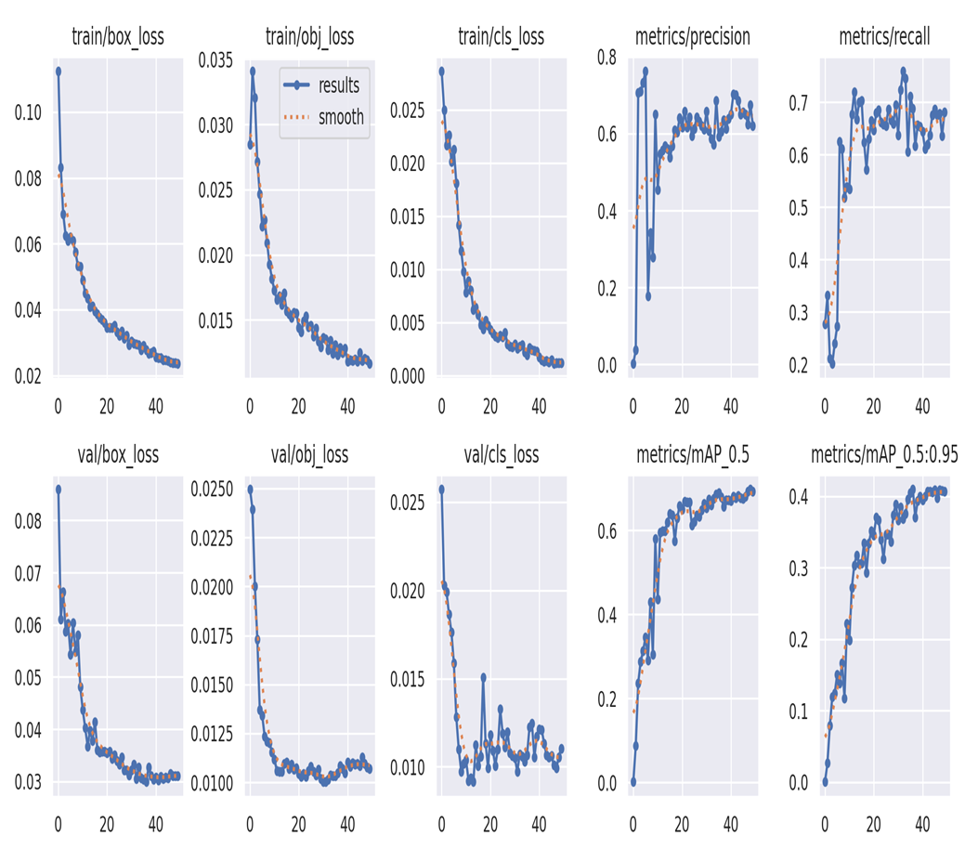
Results
Streamlit Website
Streamlit was used to build a website for the user to interact with and the model was loaded to the website. A simplistic interface was designed. Users can enter URL in the field to check if it Phishing or Legitimate.

Slide 25
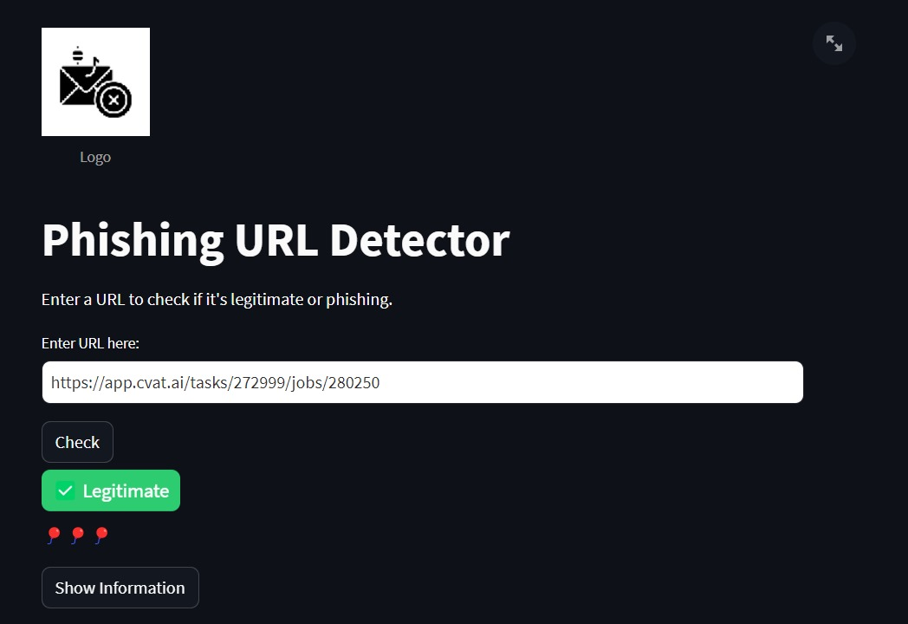
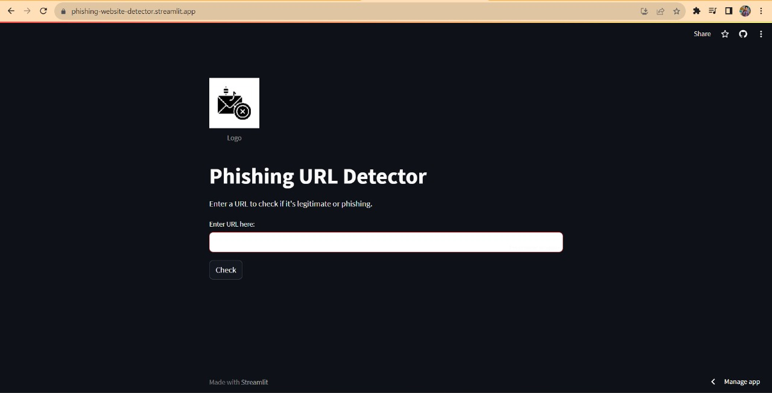
Results
Random Forest Classifier
A Random Forest classifier model was implemented to determine whether a link is legitimate or potentially malicious. The model was trained using a labeled dataset consisting of legitimate and phishing URLs. Features from DNS records, SSL certificates, and other relevant data were used to train the model.

Slide 26
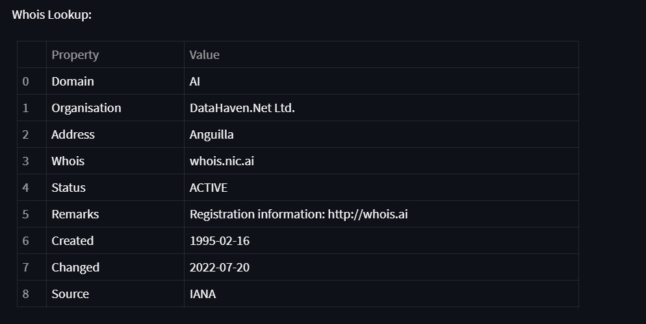
Results
WHOIS Server Analysis
WHOIS server information was retrieved for each domain to analyze domain ownership and registration details. This information provided insights into the legitimacy of the domain and its registration history.

Slide 27
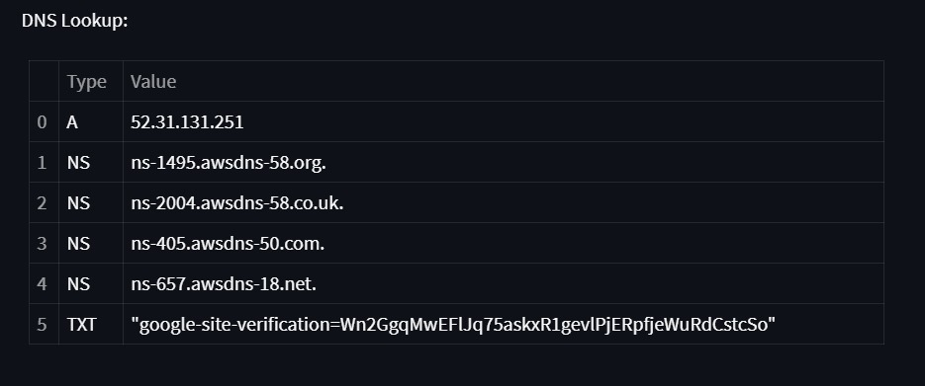
Results
SSL Certificate Examination:
All SSL certificates associated with the target website were found to be valid and properly configured. They were issued by reputable Certificate Authorities and were correctly matched to the respective domains. The certificates exhibited strong encryption algorithms, ensuring secure communication between users and the website.

Slide 28
Results
DNSSEC Certificate Validation:
The DNSSEC certificates for the target website were found to be correctly implemented and validated. The DNSSEC signatures were properly aligned with the DNS records, ensuring the authenticity and integrity of the domain's DNS data. This enhances the trustworthiness of the DNS information provided to users.

Slide 29
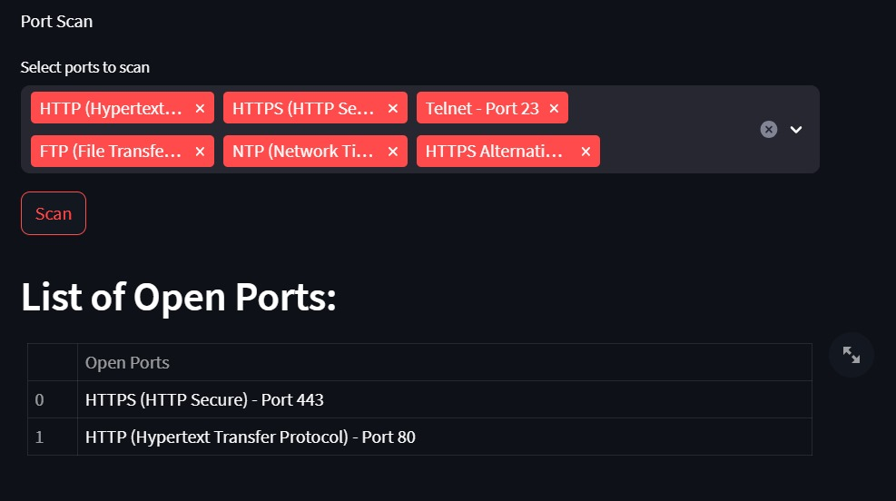
Results
Port Scanning:
The port scanning procedure revealed a set of open ports on the target server. These ports included: Port 80 (HTTP) & Port 443 (HTTPS)
The open ports were within the expected range for common web services. No ports associated with high-risk or vulnerable services were detected during the scan.

Slide 30
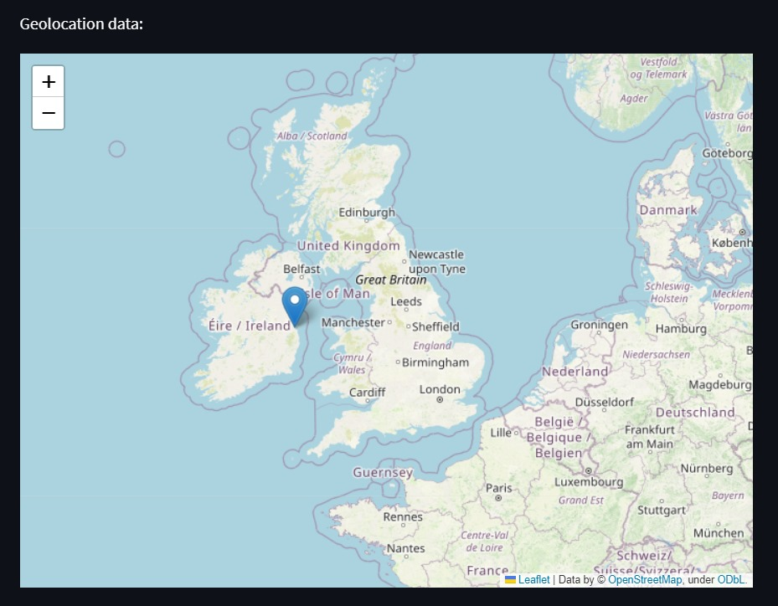
Results
Server Geolocation:
The geolocation of the target server's IP address was determined to be in the same country as the legitimate website's expected location. This alignment with the expected geographic location provides confidence that the server is hosted in a legitimate environment.

Slide 31
Conclusion

Slide 32
Conclusions
The implementation of the phishing link classifier website, utilizing methods like DNS analysis, SSL certificate examination, port scanning, DNSSEC validation, and server geolocation, has yielded positive outcomes. This multifaceted approach effectively identifies potential phishing links and enhances user security.
After comprehensive analysis, including DNS records, SSL certificates, open ports, DNSSEC certificates, and server geolocation, the evaluated website is found to align with legitimate practices. No phishing attempts or security vulnerabilities were detected.
The success of this system highlights the value of integrating diverse security techniques for robust protection against evolving cyber threats. However, ongoing monitoring and updates are crucial due to the dynamic threat landscape and emerging phishing tactics.

Slide 33
References
A. Alswailem, B. Alabdullah, N. Alrumayh and A. Alsedrani, "Detecting Phishing Websites Using Machine Learning," 2019 2nd International Conference on Computer Applications & Information Security (ICCAIS), Riyadh, Saudi Arabia, 2019, pp. 1-6, doi: 10.1109/CAIS.2019.8769571.
L. R. Kalabarige, R. S. Rao, A. Abraham and L. A. Gabralla, "Multilayer Stacked Ensemble Learning Model to Detect Phishing Websites," in IEEE Access, vol. 10, pp. 79543-79552, 2022, doi: 10.1109/ACCESS.2022.3194672.
M. Chatterjee and A. -S. Namin, "Detecting Phishing Websites through Deep Reinforcement Learning," 2019 IEEE 43rd Annual Computer Software and Applications Conference (COMPSAC), Milwaukee, WI, USA, 2019, pp. 227-232, doi: 10.1109/COMPSAC.2019.10211.
Malicious URLs Dataset, Kaggle - https://www.kaggle.com/datasets/sid321axn/malicious-urls-dataset
SafeLink: Malicious URLs Detection System, Kaggle - https://www.kaggle.com/code/thisishusseinali/safelink-malicious-url-detection-system
Java Point - https://www.javatpoint.com/machine-learning-random-forest-algorithm
Analytics Vidya - https://www.analyticsvidhya.com/blog/2021/06/understanding-random-forest/
Simpli Learn - https://www.simplilearn.com/tutorials/machine-learning-tutorial/random-forest-algorithm
Wikipedia - https://en.wikipedia.org/wiki/Random_forest
Towards Data Science - https://towardsdatascience.com/understanding-random-forest-58381e0602d2

Slide 34
Thank You!

